Slide 1
Events
Webhooks

Slide 3
How to View This Presentation
To switch to Notes Page view:
On the ribbon, click the View tab, and then click Notes Page
To navigate through notes, use the Page Up and Page Down keys
Zoom in or zoom out, if required
In the Notes Page view, you can:
Read any supporting text—now or after the delivery
Add notes to your copy of the presentation, if required
Take the presentation files home with you

Slide 4
Overview
What are Webhooks
In this Lesson
How to use Webhooks
When to use Webhooks

Slide 5
Objectives
Learn when Webhooks can be used
Understand how to work with Webhooks
Know the limitations of using Webhooks

Slide 6
What are Webhooks
Web standard for responding to events
Easier to develop and consume than Windows Communication Foundation (WCF) used in Remote Event Receivers
Subscribe to events
SharePoint triggers your custom WebAPI
Notes:
Webhooks is a web standard for getting notified about events occurring on a system (https://en.wikipedia.org/wiki/Webhook).
This technology is easier to develop and consume than WCF services used in RERs as there’s no need to implement a specific interface class or obey to the WCF rules for communication.
You subscribe to a specific event you want to be notified about when it occurs within SharePoint.
In the event of something happening in SharePoint which triggers a webhook subscription, SharePoint will make a call to the webservice you provided during subscription phase to notify it of the event. There’s no need to constantly poll SharePoint for changes from your custom code.
More information:
https://docs.microsoft.com/en-us/sharepoint/dev/apis/webhooks/overview-sharepoint-webhooks

Slide 7
When to use Webhooks
When using SharePoint Online or SharePoint 2019
When wanting to be notified about List Item changes
When wanting to trigger a non .NET service
When wanting to obey to the current webservice standard
Notes:
Webhooks in SharePoint is currently only possible when using SharePoint Online or SharePoint 2019 and specifically when targeting SharePoint List Items. Other SharePoint on-premises versions and other components in SharePoint Online are not yet activated for use with webhooks.
If you need to trigger a non .NET service, webhooks would be a better option as you don’t need to try to have your non .NET webservice implement the required interface that Remote Event Receivers require.
Another reason could be you wish to stick with the current standard for webservices: WebAPI. This works cross platform, so no need to build separate services just to handle SharePoint events.

Slide 8
Supported Webhook Events
SharePoint List Item Webhook Events
ItemAdded
ItemUpdated
ItemDeleted
ItemCheckedIn
ItemCheckedOut
ItemUncheckedOut
ItemAttachmentAdded
ItemAttachmentDeleted
ItemFileMoved
ItemFileConverted
ItemVersionDeleted
Notes:
This slide lists the currently available SharePoint List Item events to which you can subscribe.
SharePoint webhooks only support asynchronous events. This means that webhooks are only fired after a change happened (similar to -ed events), and thus synchronous (-ing events) are not possible.
More information:
https://docs.microsoft.com/en-us/sharepoint/dev/apis/webhooks/lists/overview-sharepoint-list-webhooks

Slide 9
How to use Webhooks
Build your WebAPI service to receive events
Subscribe to a webhook
Respond to validation HTTP Post
Start receiving events
Respond to events within 5 seconds
Re-register webhook within 6 months
Notes:
If you want to start using Webhooks, you need to:
Build a WebAPI service that will receive and process the events
Subscribe to a webhook so your service will start receiving events
When subscribing, SharePoint will issue a HTTP Post to the service URL you register to validate that the service works. You need to respond to it in a timely manner or the subscription will not be created.
Start receiving the events on your service
Every event sent to your webservice MUST respond within 5 seconds or it will be considered failed by SharePoint and retried for 4 additional times with 5 minute intervals
Make sure you re-register the webhook within 6 months or otherwise the registration will expire automatically

Slide 10
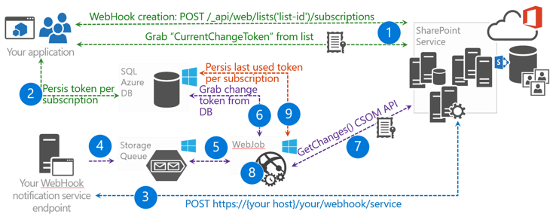
Webhooks end to end flow
Notes:
Your application creates a webhook subscription. When it does, it gets the current changeToken from the list it created the webhook for.
Your application persists the changeToken in a persistent storage, such as SQL Azure in this case.
A change in SharePoint occurs, and SharePoint calls your service endpoint.
Your service endpoint serializes the notification request and stores it in a storage queue.
Your web job sees the message in the queue and starts your message processing logic.
Your message processing logic retrieves the last used change token from the persistent storage.
Your message processing logic uses the GetChanges() API to determine what changed.
The returned changes are processed and now your application performs what it needs to do based on the changes.
Finally, the application persists the last retrieved changeToken so that next time it does not receive changes that were already processed.
More information: https://docs.microsoft.com/en-us/sharepoint/dev/apis/webhooks/webhooks-reference-implementation

Slide 11
Webhook Tasks
Create new subscription
POST /_api/web/lists/ getbytitle('list-title')/subscriptions
Get subscriptions
GET /_api/web/lists/ getbytitle('list-title')/subscriptions
Delete a subscription
DELETE /_api/web/lists/ getbytitle(‘list-title')/subscriptions('id')
Update a subscription
PATCH /_api/web/lists/ getbytitle('list-title')/subscriptions('id')
Notes:
This slide shows how you can work with subscriptions of webhooks. You can call these SharePoint REST endpoints to perform the desired operation.
More information:
https://docs.microsoft.com/en-us/sharepoint/dev/apis/webhooks/lists/overview-sharepoint-list-webhooks

Slide 12
Creating a new Webhook subscription
Needed for subscribing
Resource to subscribe to
Notification URL
Expiration date (< 6 mths)
Client State (optional)
Confirm registration
SharePoint will issue HTTP Post
Respond to post to confirm subscription with validationToken={string} querystring token as the HTTP return body
{
"resource": "https://contoso/_api/web/lists/getbytitle(‘My List')",
"notificationUrl": "https://localhost:44374/api/webhooks",
"expirationDateTime": "2018-12-11T23:17:57+00:00",
"clientState": ""
}
Notes:
Resource - The resource endpoint URL you are creating the subscription for. For example a SharePoint List API URL.
Server notification URL - Your service endpoint URL. SharePoint will send an HTTP POST to this endpoint when events occur in the specified resource.
Expiration date - The expiration date for your subscription. The expiration date should not be more than 6 months. By default, subscriptions are set to expire 6 months from when they are created.
Client State – An optional opaque string passed back to the client on all notifications. You can use this for validating notifications, tagging different subscriptions, or other reasons.
After requesting the subscription, SharePoint will send a HTTP Post message to the Notification URL you provided to test if the service is available. In the querystring it will provide a parameter called validationToken. Provide that exact value in a HTTP 200 OK response its body in order for the webhook registration to be completed.
More information:
https://docs.microsoft.com/en-us/sharepoint/dev/apis/webhooks/overview-sharepoint-webhooks#creating-webhooks
[ServiceContract(Namespace = "http://schemas.microsoft.com/sharepoint/remoteApp/")]
public interface IRemoteEventService
{
[OperationContract]
SPRemoteEventResult ProcessEvent(SPRemoteEventProperties properties);
[OperationContract(IsOneWay = true)]
void ProcessOneWayEvent(SPRemoteEventProperties properties);
}

Slide 13
Keeping Webhook subscription alive
Webhook subscriptions expire after 6 months
Build a custom service to run regularly to renew subscriptions
When receiving notifications, send a renew request to extend with another 6 months
Notes:
Webhook registrations expire after 6 months of having registered them. You cannot change this. You can however register them again to have another 6 months from that date. The recommended approach is to write a piece of code that runs regularly to update your webhook registrations to keep them alive. An alternative option would be to incorporate in the service which is receiving the notifications from the webhook to register the webhook again. Possible risk with the latter would be that if no notifications are received within 6 months, the registration will expire and will get removed.
[ServiceContract(Namespace = "http://schemas.microsoft.com/sharepoint/remoteApp/")]
public interface IRemoteEventService
{
[OperationContract]
SPRemoteEventResult ProcessEvent(SPRemoteEventProperties properties);
[OperationContract(IsOneWay = true)]
void ProcessOneWayEvent(SPRemoteEventProperties properties);
}

Slide 14
Receiving notifications
The unique identifier for the subscription
Notifications may be batched
An optional string value that is passed back in the notification message for this subscription
The date and time when the subscription will expire if not updated or renewed
{
"value":[
{
"subscriptionId":"91779246-afe9-4525-b122-6c199ae89211",
"clientState":"00000000-0000-0000-0000-000000000000",
"expirationDateTime":"2018-12-10T17:27:00.0000000Z",
"resource":"b9f6f714-9df8-470b-b22e-653855e1c181",
"tenantId":"00000000-0000-0000-0000-000000000000",
"siteUrl":"/",
"webId":"dbc5a806-e4d4-46e5-951c-6344d70b62fa"
}
]
}
Unique identifier of the list where the subscription is registered
Server relative URL of the site where the subscription is registered
The unique identifier for the subscription resource
Unique identifier of the web where the subscription is registered
Notes:
This shows a sample notification which can be received by your service after subscribing to a webhook in SharePoint. Notice that SharePoint may decide to batch multiple notifications in one, causing an array to be sent over. The boxes on this slide explain the purpose of each item in the JSON message.
More information:
https://docs.microsoft.com/en-us/sharepoint/dev/apis/webhooks/overview-sharepoint-webhooks#receiving-notifications
[ServiceContract(Namespace = "http://schemas.microsoft.com/sharepoint/remoteApp/")]
public interface IRemoteEventService
{
[OperationContract]
SPRemoteEventResult ProcessEvent(SPRemoteEventProperties properties);
[OperationContract(IsOneWay = true)]
void ProcessOneWayEvent(SPRemoteEventProperties properties);
}

Slide 15
Receiving notifications
What about the change itself?
Not included in the webhook event
Need to trigger GetChanges API manually to find out what has changed
Notes:
TODO: INCLUDE CSOM CODE SAMPLE
As you may have noticed from the previous slide, the event notification does not contain any information about what triggered the event or what changed. You need to explicitly call the GetChanges API in SharePoint to find out what changed.
ChangeQuery documentation:
https://msdn.microsoft.com/en-us/library/office/dn600183.aspx?f=255&MSPPError=-2147217396#bk_ChangeQuery
GetChanges API documentation:
https://msdn.microsoft.com/EN-US/library/office/dn531433.aspx?f=255&MSPPError=-2147217396#bk_ListGetChanges
[ServiceContract(Namespace = "http://schemas.microsoft.com/sharepoint/remoteApp/")]
public interface IRemoteEventService
{
[OperationContract]
SPRemoteEventResult ProcessEvent(SPRemoteEventProperties properties);
[OperationContract(IsOneWay = true)]
void ProcessOneWayEvent(SPRemoteEventProperties properties);
}

Slide 16
Retry mechanism
In case your WebAPI service is down
SharePoint will retry 5 times with 5 minute intervals
Subscription will remain and new notifications will be delivered to the service again
Notes:
In the scenario where SharePoint is unable to reach your WebAPI service registered through a webhook, SharePoint will retry calling the service 5 times with 5 minute intervals max. After this, the subscription will be removed automatically by SharePoint.
[ServiceContract(Namespace = "http://schemas.microsoft.com/sharepoint/remoteApp/")]
public interface IRemoteEventService
{
[OperationContract]
SPRemoteEventResult ProcessEvent(SPRemoteEventProperties properties);
[OperationContract(IsOneWay = true)]
void ProcessOneWayEvent(SPRemoteEventProperties properties);
}

Slide 17
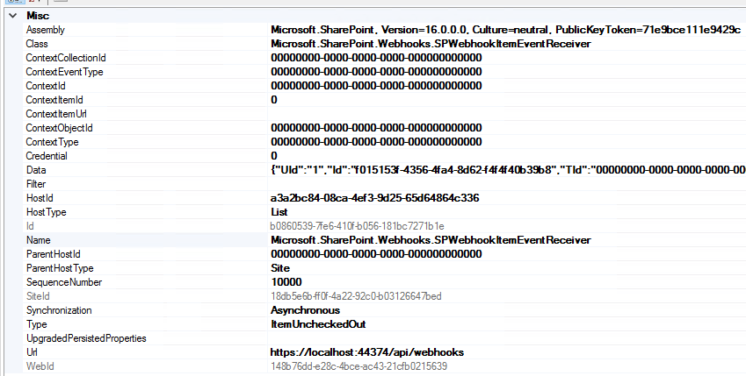
Behind the scenes
Creating a WebHook subscription creates 12 Event Receivers
Notes:
If you subscripe to a webhook on a list, it will create 12 asynchronous event receivers on that list for each subscription to capture all the supported events for a webhook on that list. Notice that the Data property contains the specific information such as the webhook identifier and the client state you may have provided during the registration.
[ServiceContract(Namespace = "http://schemas.microsoft.com/sharepoint/remoteApp/")]
public interface IRemoteEventService
{
[OperationContract]
SPRemoteEventResult ProcessEvent(SPRemoteEventProperties properties);
[OperationContract(IsOneWay = true)]
void ProcessOneWayEvent(SPRemoteEventProperties properties);
}

Slide 18
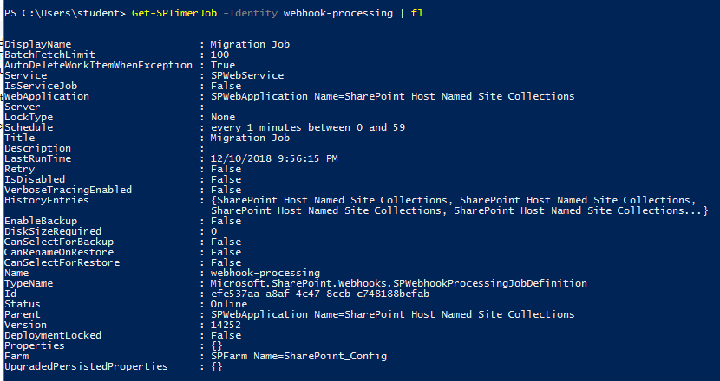
Behind the scenes
Timerjob “Migration Job” takes care of sending the requests to subscribers based on a 1-minute interval
Notes:
The timerjob “Migration Job” (internal name webhook-processing) takes care of fetching all the queued messages from list changes containing webhook subscriptions and contacting the registered webhook hosts to notify them of a change having occurred. This Timerjob runs once every minute, so there will always be a delay between performing n action on a list and receiving a notification through the webhook subscription.
[ServiceContract(Namespace = "http://schemas.microsoft.com/sharepoint/remoteApp/")]
public interface IRemoteEventService
{
[OperationContract]
SPRemoteEventResult ProcessEvent(SPRemoteEventProperties properties);
[OperationContract(IsOneWay = true)]
void ProcessOneWayEvent(SPRemoteEventProperties properties);
}

Slide 19
Knowledge Check
Webhooks work with which item type in SharePoint?
What happens if the WebAPI service is down for 30 minutes?
Use the GetChanges API to check for changes
How do we find out what was changed when a webhook triggers?
List Items
The webhook subscription will automatically be removed after 5 unsuccessful attempts with 5 minute intervals

Slide 20
Lesson Summary
Webhooks can only be used with SharePoint 2019 and Online
Webhooks are only supported with List Items
You need to subscribe to start receiving notifications
Notifications do not include the actual change
GetChange API needs to be queried to find out what changed

Slide 21
Questions?

Slide 22
Lab: Webhooks
…
Time estimation: xx minutes
Notes:
This lab is still being created and is therefore not yet available

